Slide 1
MYLEGION: REPORTS
LGN and SAL Consolidated, Membership, and Revitalization reports. Create a renewal letter and labels.
2027
CPR/CSR
Renewal Letter
Post/Sqdn Current Roster
HQ Transfer Inv Ltr
Roster Updates
HQ Listing
Member Dues History
Project Stay Active
Roster Updates
MyLegion Access
Paid Members by Post
Post Officers
3x 10 Labels
Health Status

Slide 2
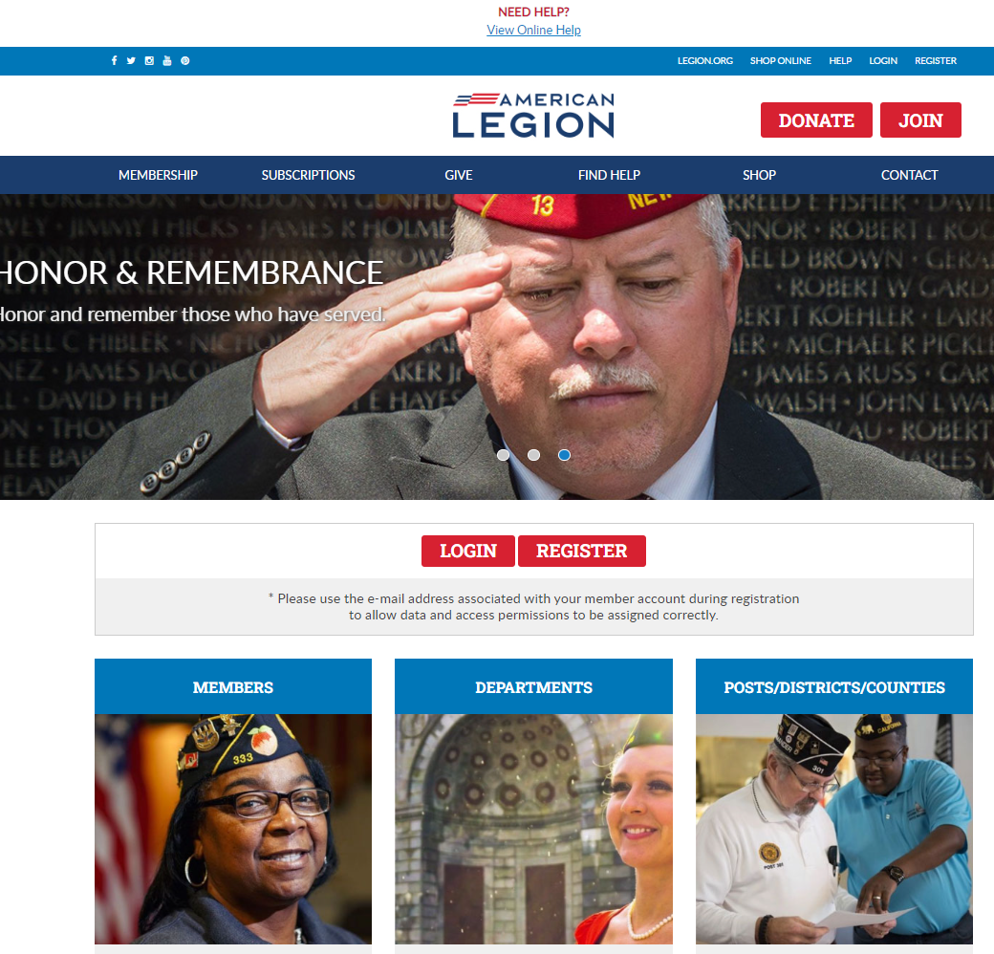

Log in or register a myLegion account to view and manage membership.
Notes:
Administrative membership management tools are available through MyLegion. Begin by logging into MyLegion and proceed to the My Groups menu.

Slide 3
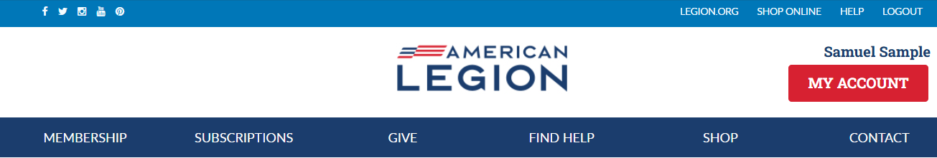
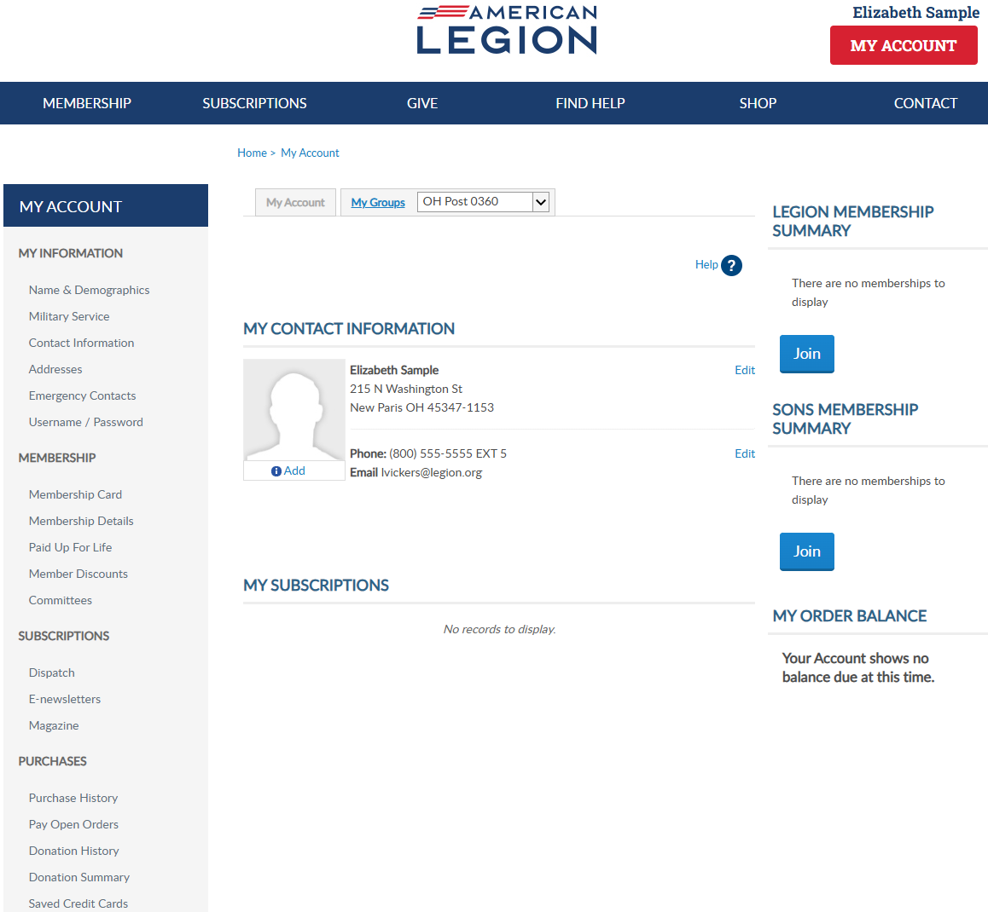
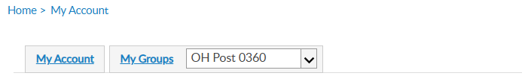

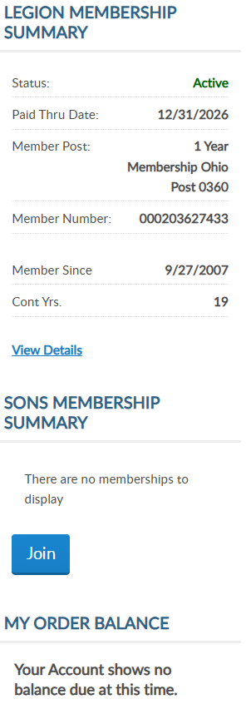
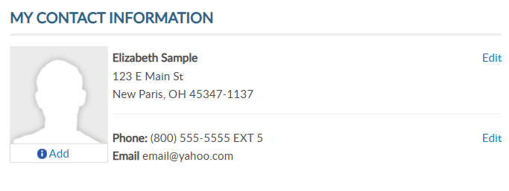
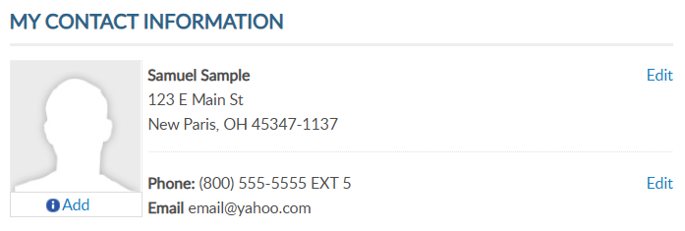
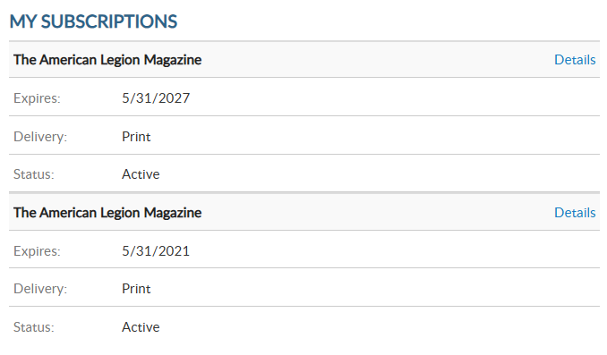
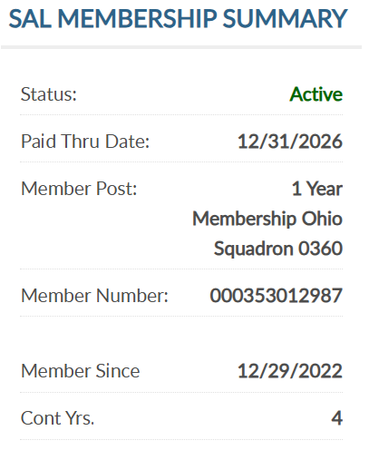

Adjutants, commanders and assigned admins will have a MyGroups menu.
MYLEGION.ORG
No group menu? Contact your department headquarters.
12/31/2027
000123456789
20
5/31/2028
12/31/2027
000123456789
5
Notes:
My Groups is the administrative side of myLegion available to adjutants and commanders and assigned administrators. If you do not have a My Groups menu and are a current adjutant or commander, contact your department headquarters.

Slide 4
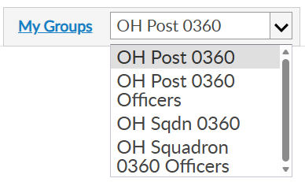
MY GROUPS
Adjutants and Commanders
Post, Squadron, District, County, Dept, Detach
Legion has LGN and SAL
Officer Groups: view only
12/31/2027
Select group to transition to the admin side of myLegion.
000123456789
20
5/31/2028
12/31/2027
000123456789
5
Notes:
Legion leadership have access to both legion and Sons of the American Legion groups. Officer groups are view only. All officers are reported through department headquarters.
This member is a post adjutant. Post adjutants and commanders have access to both post and squadron membership and officer groups.
<1> Clicking on the group will navigate you to the administrative side of MyLegion, group profile.

Slide 5
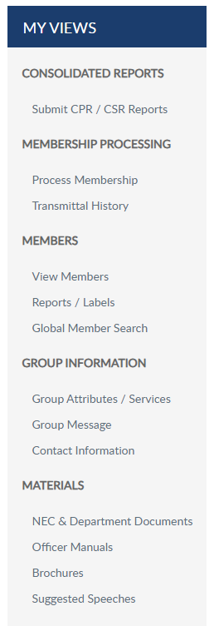
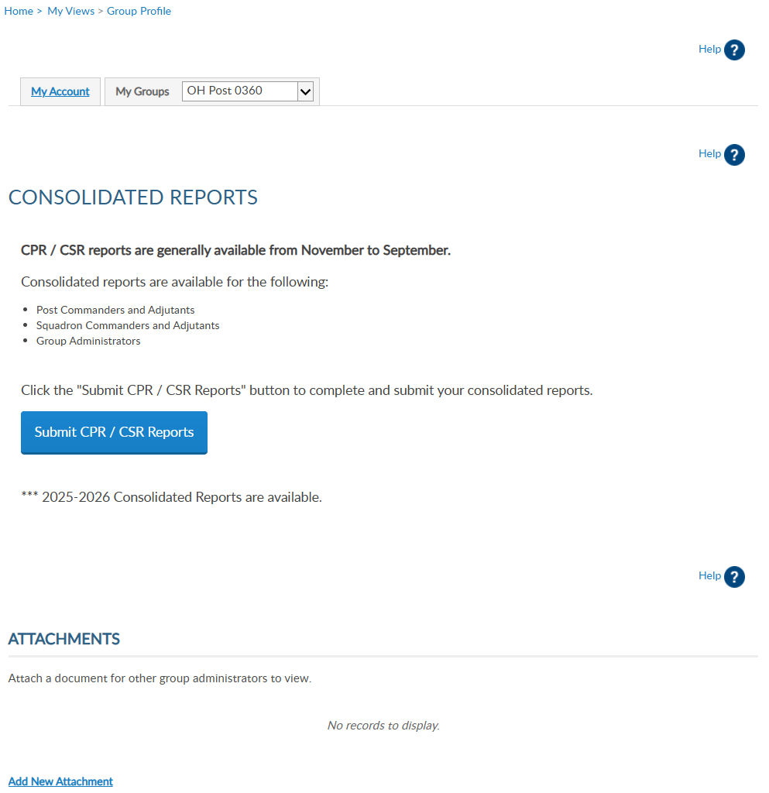
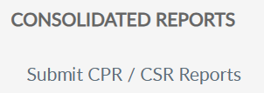
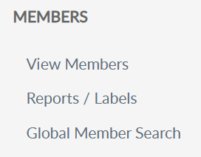
Consolidated are not always available online. National Internal Affairs will determine cut off date to accumulate totals for national convention. Generally, at the end of August reporting is cut off to update and reload a new CPR/CSR for the next year.
Notes:
MyLegion reports are found on the left menu. Consolidated reports also display on the main landing page dashboard. To submit or view a consolidated report, select “Submit CPR/CSR Reports.
<1>Consolidated are not always available online. National Internal Affairs will determine cut off date to accumulate totals for national convention. Generally, at the end of August reporting is cut off to update and reload a new CPR/CSR for the next year.

Slide 6
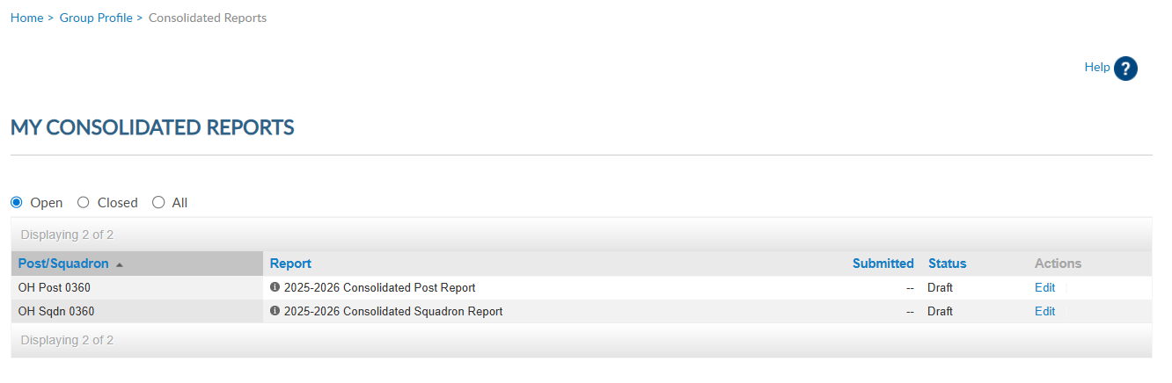
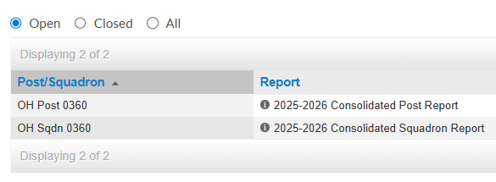
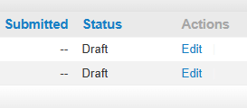
Do not submit a paper form if submitting online.
Departments have access to online reports.
Notes:
There are 3 view areas in consolidated reports. Open reports are available to enter data while in draft status.
There is only one open report for the reporting year. When available, you can edit the report until the report is submitted or until the final submission date.
To enter information in the report, click Edit. If you submit online, do not mail a paper form. The department has access to submitted report data.

Slide 7
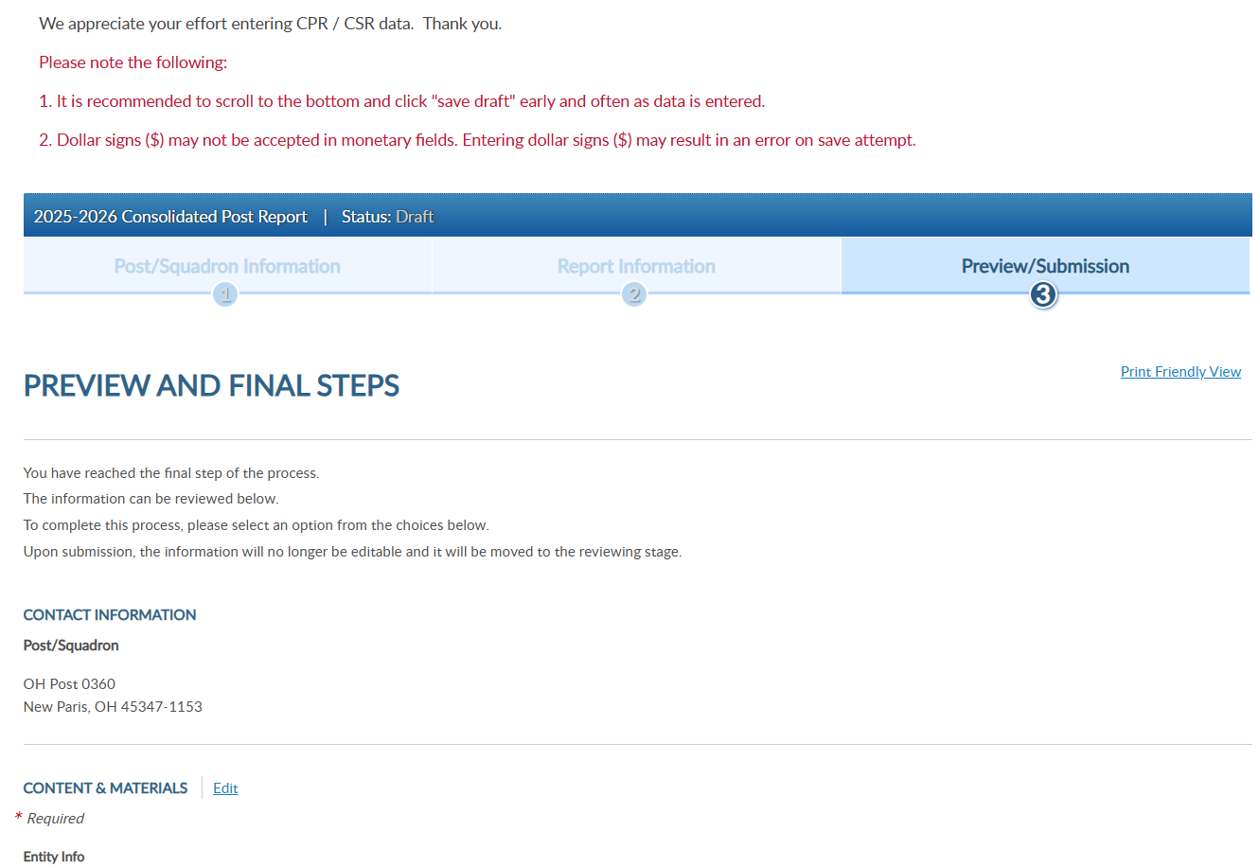
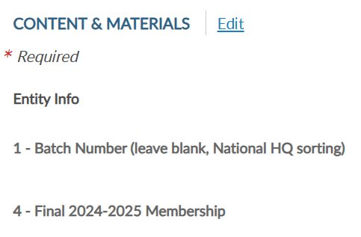
Notes:
Click edit to open the fillable form.

Slide 8
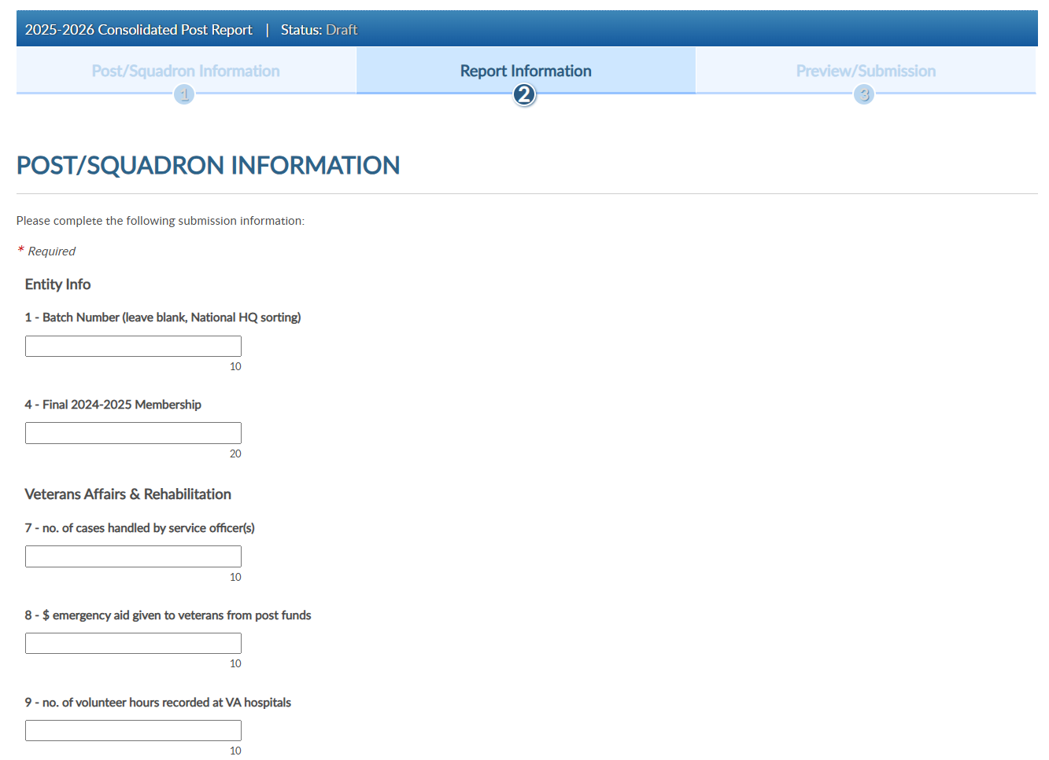
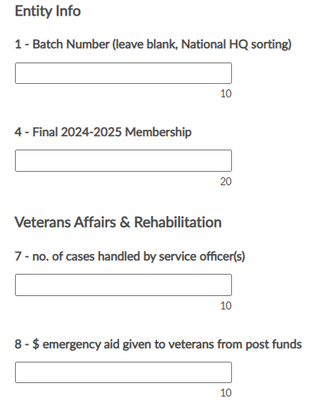
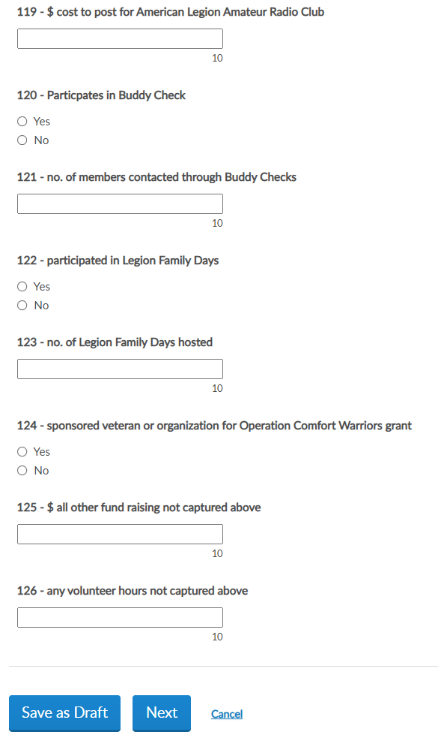

Notes:
The report questions will be grouped by area. The small number indicates the total number of characters allotted for the field.
Scroll down to continue with questions until completed or you can save the draft and finalize before the final submission date. These buttons are located at the bottom of the form. <1>

Slide 9
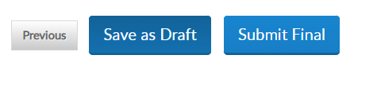
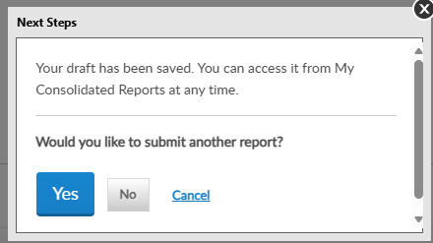
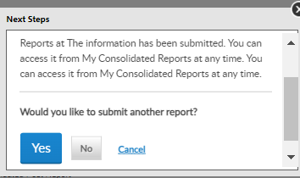
Your draft has been saved. You can access it from My Consolidated Reports at any time.
The information has been submitted. You can access it from My Consolidated Reports at any time.
Notes:
Selecting Next brings up options to Save as Draft or Submit Final. Submitting as Final will close the report for editing.

Slide 10
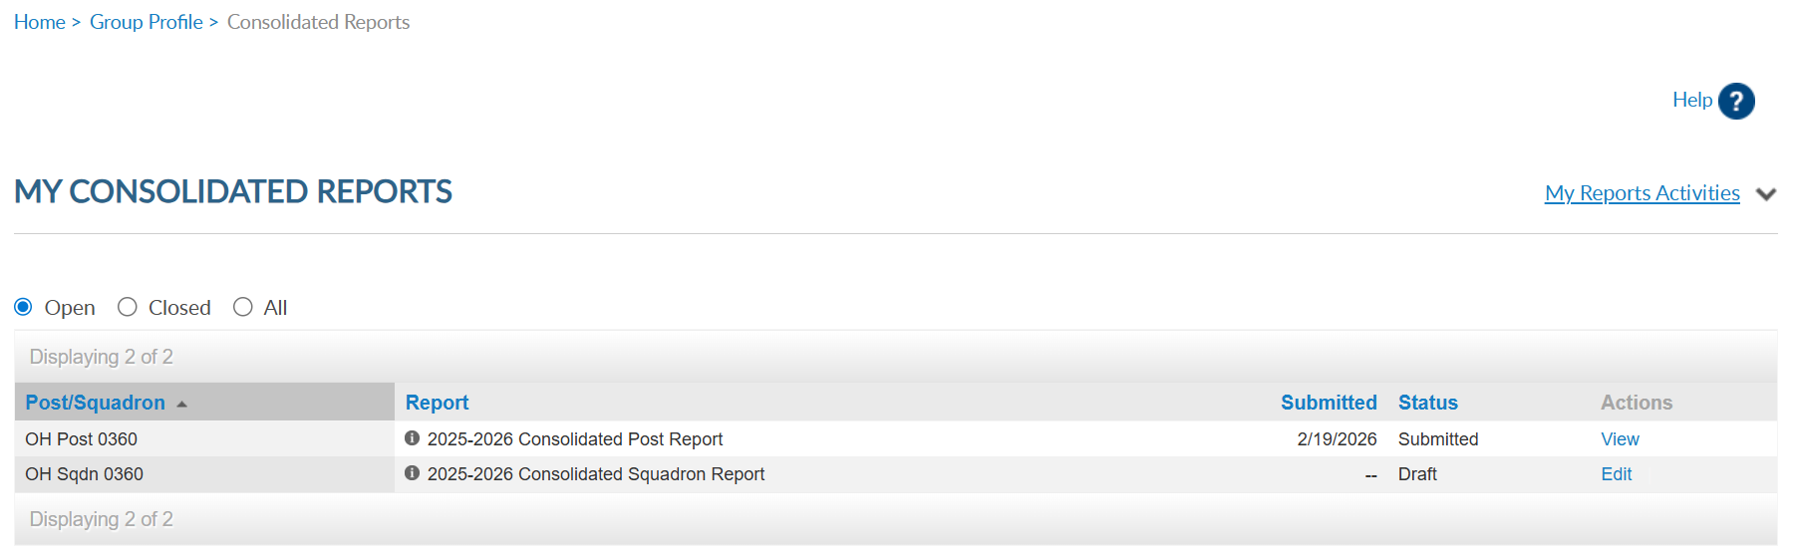
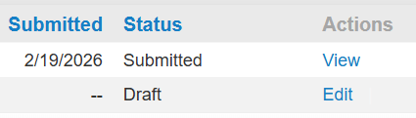
Submitted reports cannot be edited.
To re-open the report, contact myLegion@legion.org
Notes:
Submitted reports will remain in the Open area with a submitted status until the report is closed for the year.

Slide 11
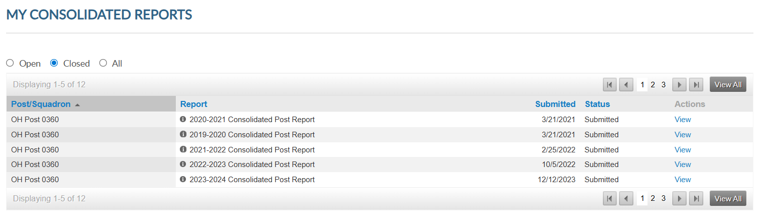


Navigation tools allow you to view page by page or “View All” to see full list.
Notes:
Closed reports do not display open reports and are view only. Use the navigational tools to view next page or full list.

Slide 12
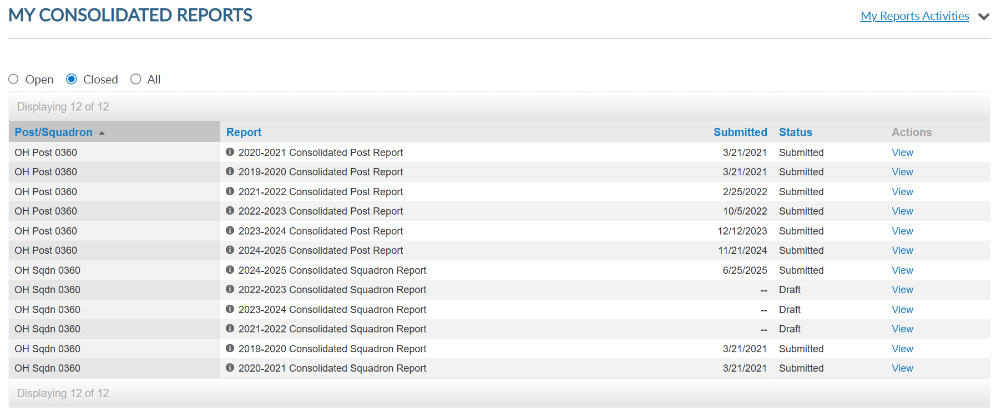
Closed reports cannot be opened for editing. You can view reports from 2019-2020 to present.
Notes:
Closed reports in draft mode are unsubmitted and are no longer available to edit and submit.

Slide 13
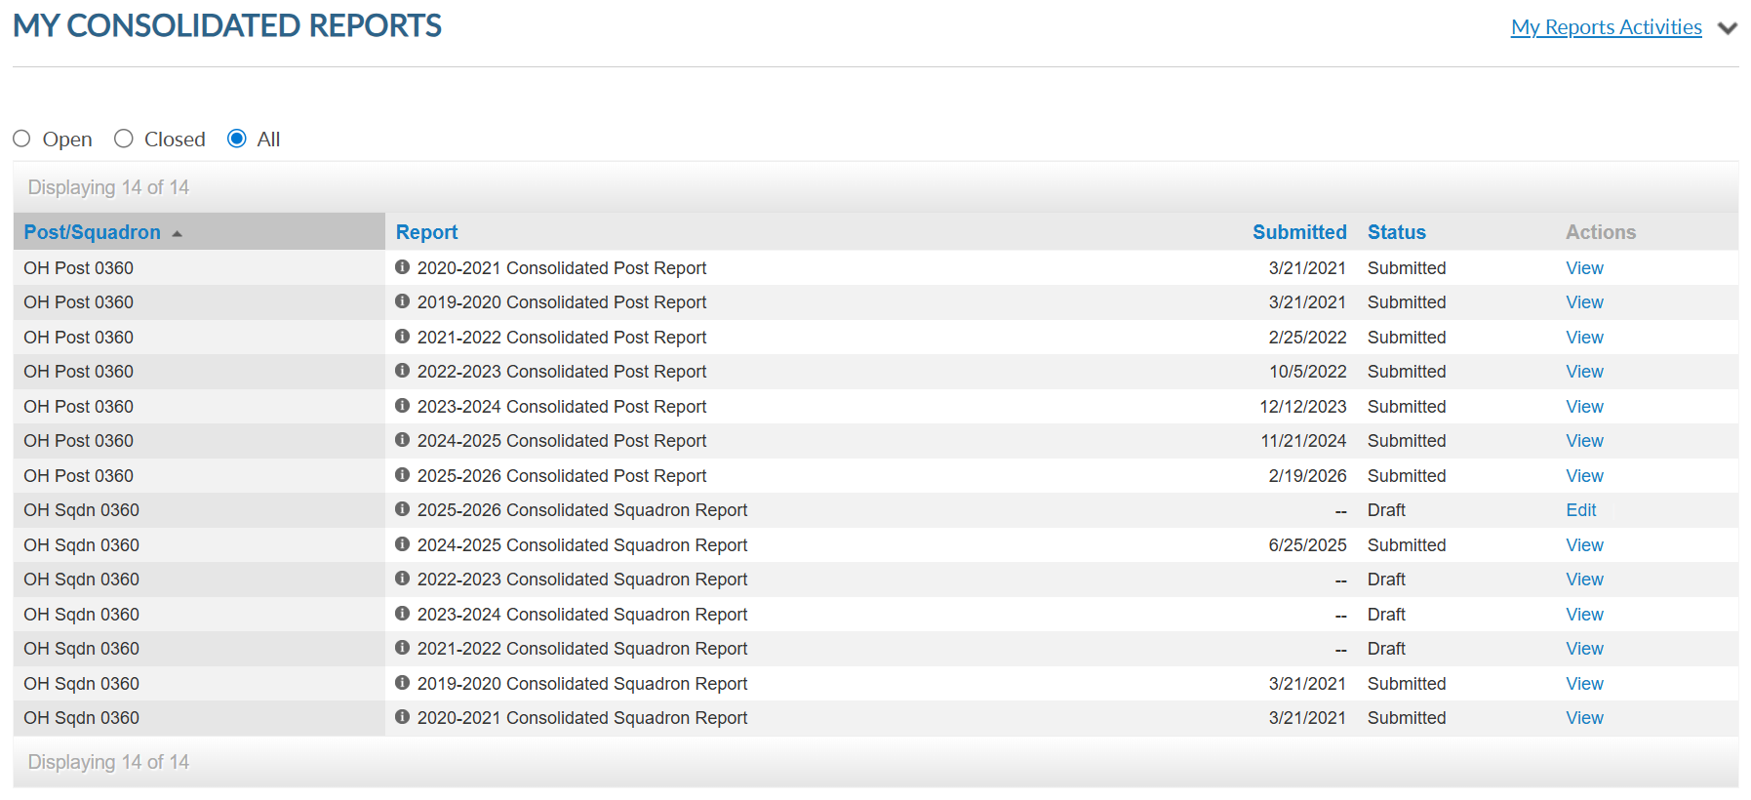

All section displays open and closed reports. Click view to open and print reports. Edit is only available for open reports.
Notes:
The All section includes open and closed reports. You can view and print all reports. Click view to open and print.

Slide 14
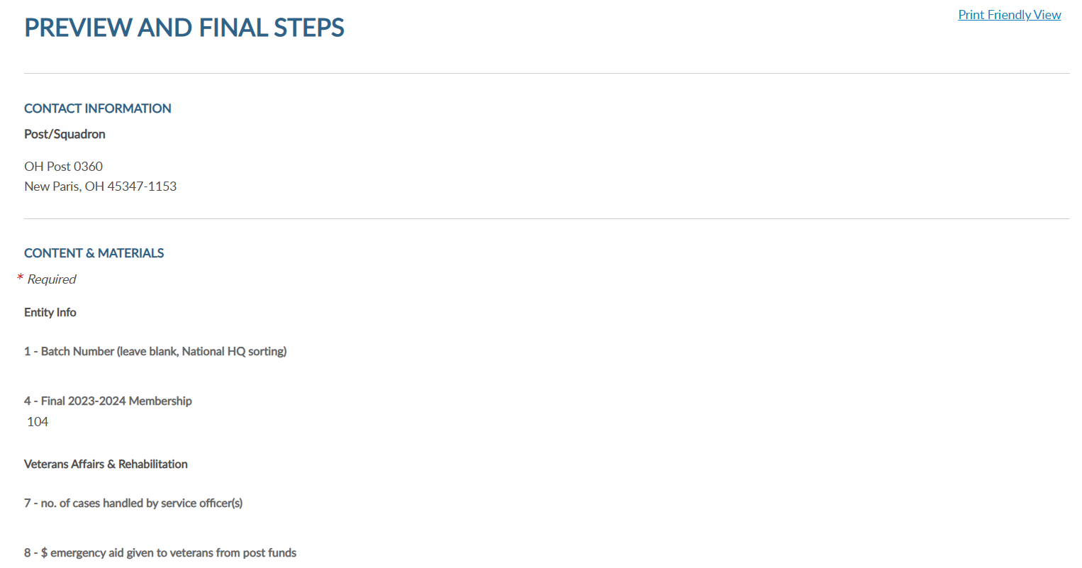

Notes:
Select Print Friendly This allows you to print the report as a PDF document.

Slide 15
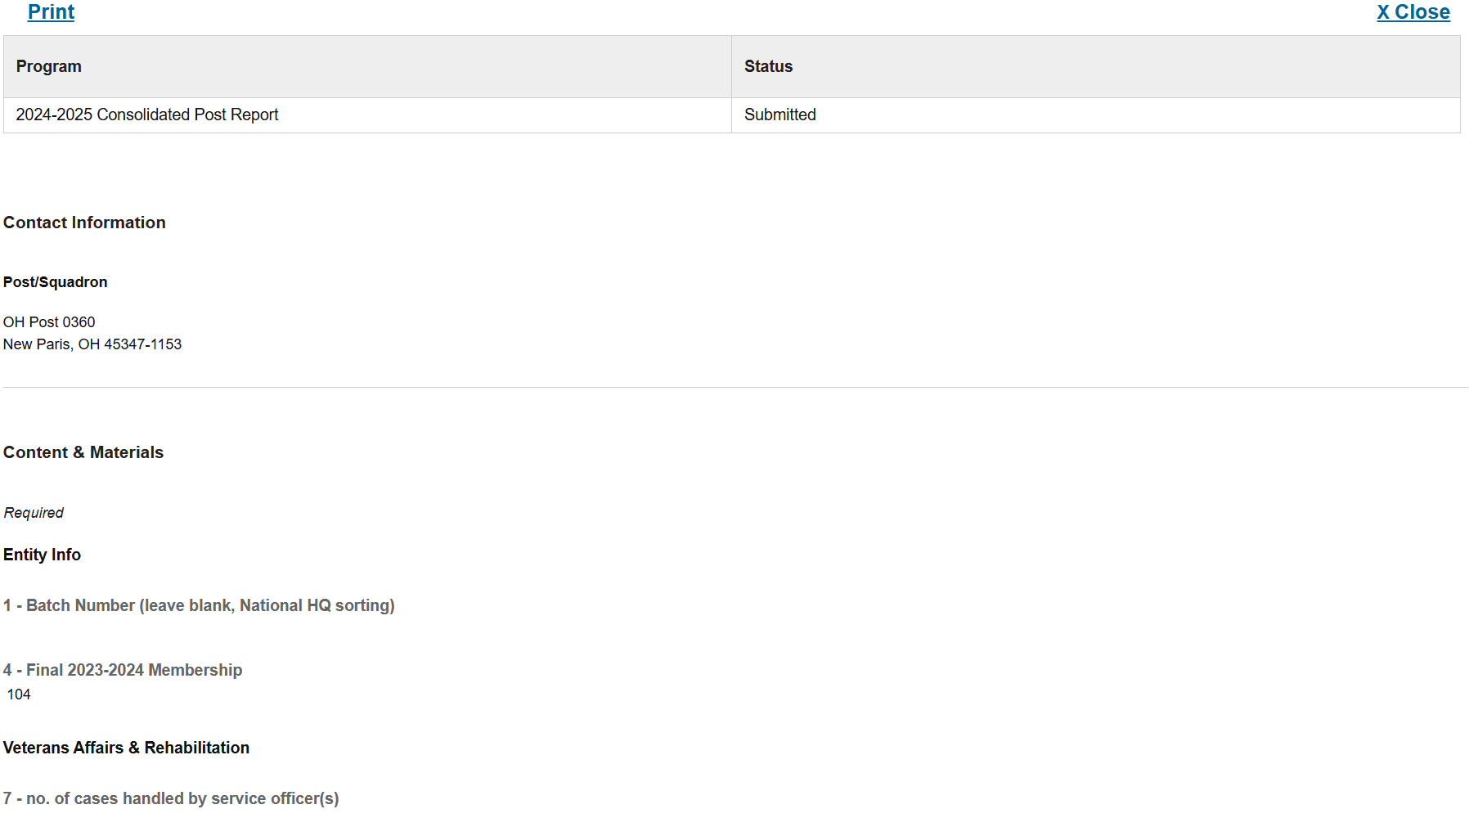
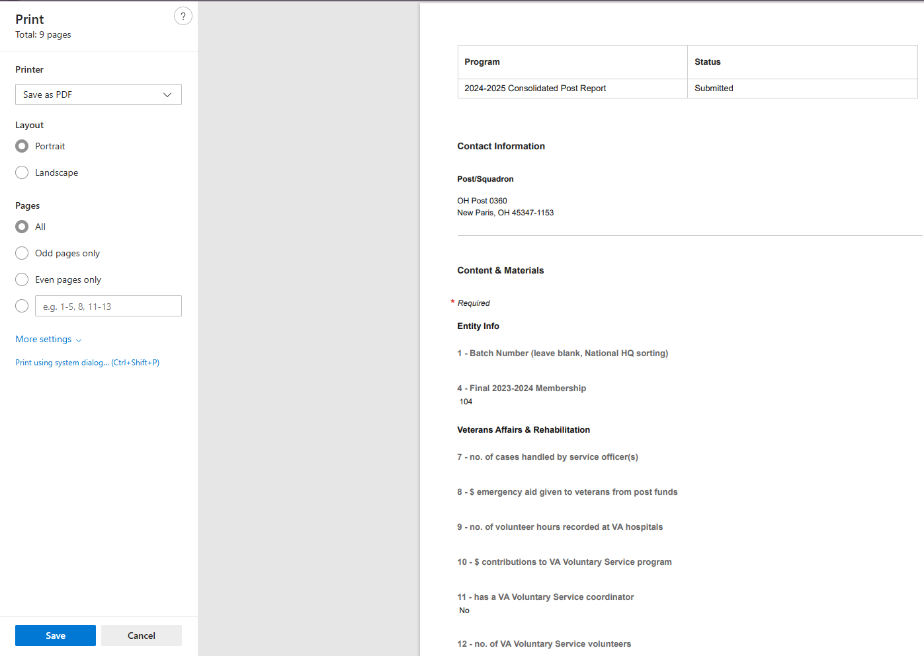
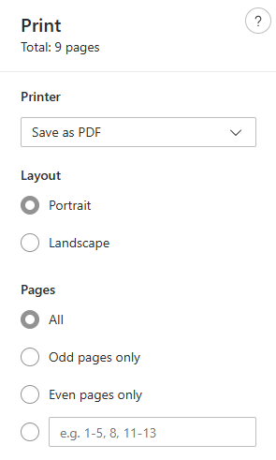

Notes:
Select print to open as a PDF document. <1> From the print window <2> you can save the document or print.

Slide 16
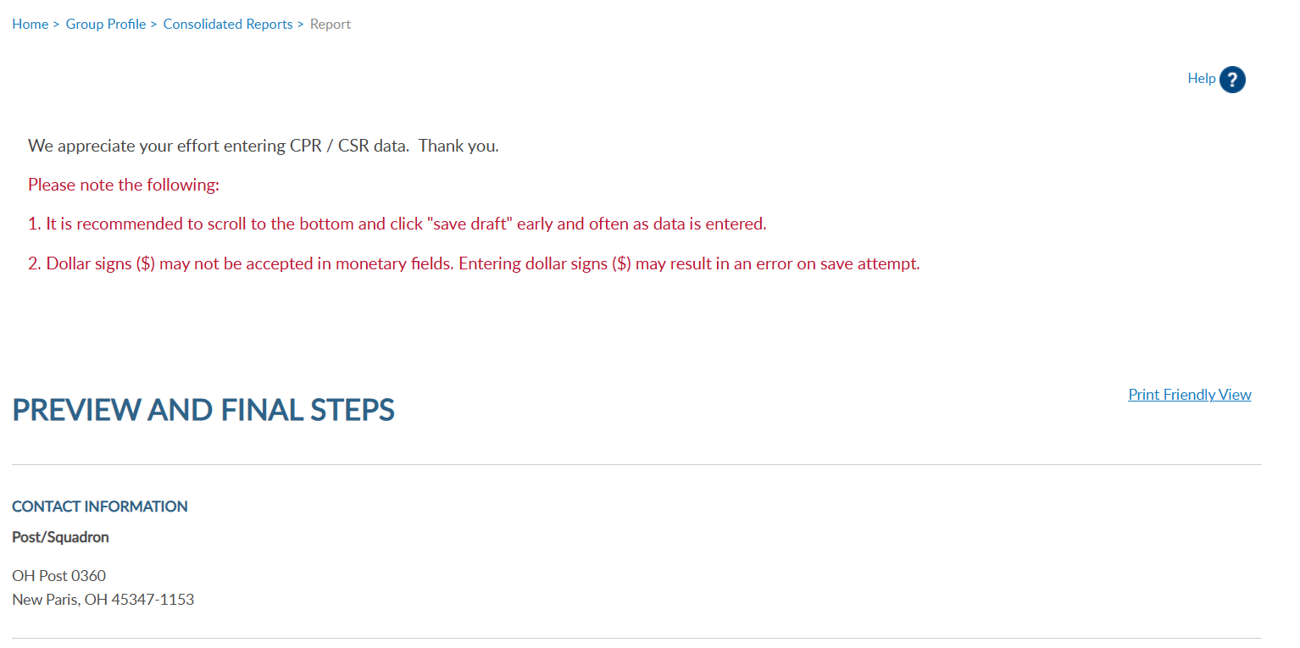
Notes:
Click on Group Profile to return to group administrative window.

Slide 17
Notes:
Membership listings, roster updates, members renewed online, HQ member listings, mailing labels and a renewal letter are available through Reports/Labels.

Slide 18
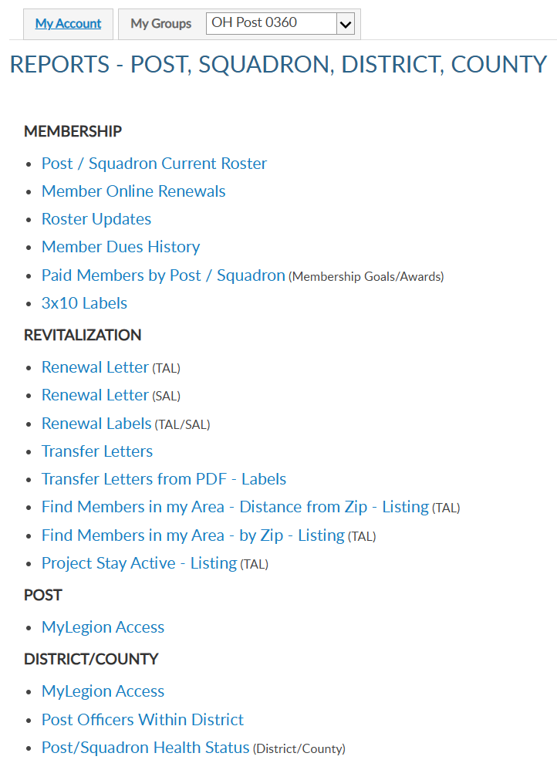
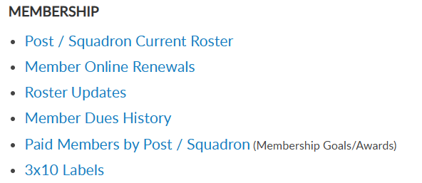
Notes:
Click on the report or letter to proceed. Let’s start with the post/squadron current roster.

Slide 19
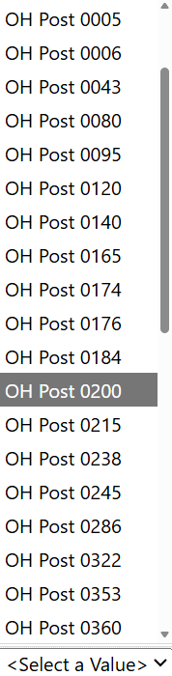
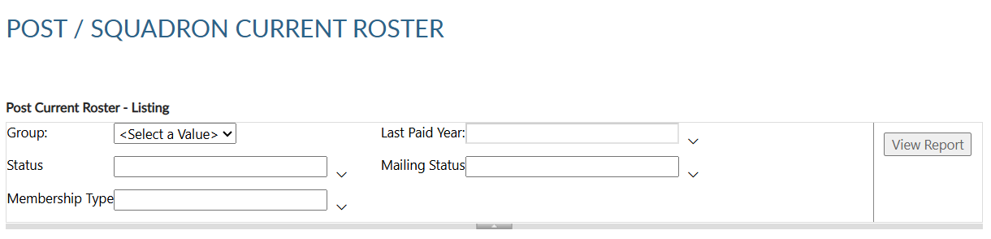
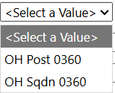
CURRENT ROSTER
Current roster includes members who are current, expired, and deceased.
Notes:
This current roster report only includes current members of your post/squadron. Members who have transferred out are not included in current membership. To view members who have paid to your post or squadron, generate a Paid Members report.
All reports are created using data filters. Filtering menus allow flexibility to the data included in the roster. <1> The first field for all reports begins with selecting a post or squadron from the pulldown menu. District and county access will provide a list including all posts assigned to the district or county.

Slide 20
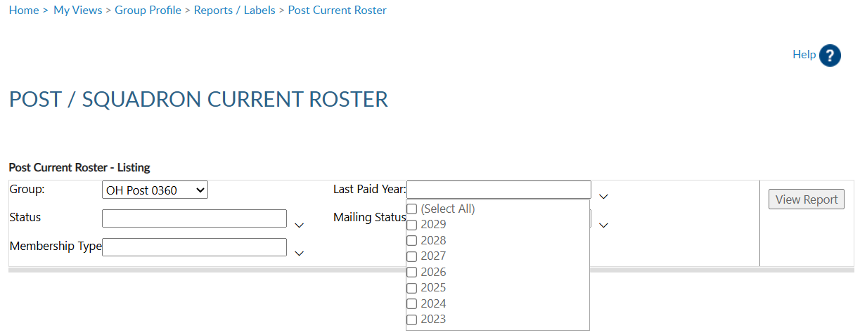
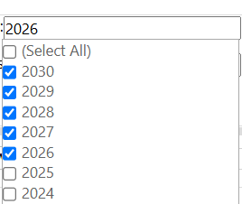
CURRENT ROSTER
Members renewing for 2027 can purchase 2027, 2028 and 2029 memberships via
3-yr online renewal option.
Paid Up For Life
Last Paid Year relies on paid year of PUFL purchase.
Check desired LPY and all greater.
Notes:
Next select last paid year. Last paid year on a member’s record will list the year of future paid years if applicable. <1> Legion members who purchase a multi-year renewal display the last paid purchased.
<2> Legion members who are currently paid and purchase a Paid up For Life membership will also display a last paid year of which PUFL allotment will be due the post.
<3> When selecting last paid year, keep in mind any members with a future last paid year, are, by definition, paid for the current year..

Slide 21
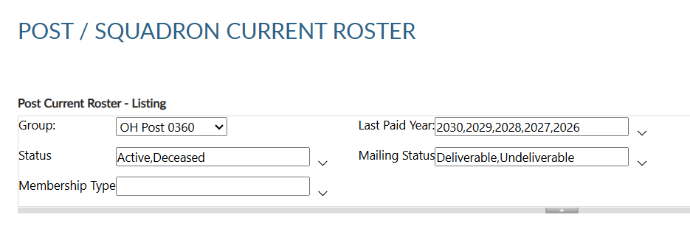


CURRENT ROSTER
Notes:
Status includes active and deceased. Deceased members will remain on the roster and can be filtered out by selecting active only.
<1> The next filter is mailing status. Mail status lets you know if the mailing address on file is good or flagged as undeliverable. Members with undeliverable status do not receive The American Legion Magazine, renewal notices, or any mailings from National Headquarters. Contact those members, if possible, to collect a valid mailing address and update. Updating an address that is marked as undeliverable will remove the flag. If a member states the address on file is good, contact National Customer Service to remove the flag.

Slide 22

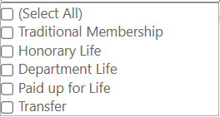
CURRENT ROSTER
Notes:
Membership type includes traditional 1-year renewal, honorary life, department life, paid up for life and if the member is a current transfer.
<1> After all data fields have been set, click View Report.

Slide 23
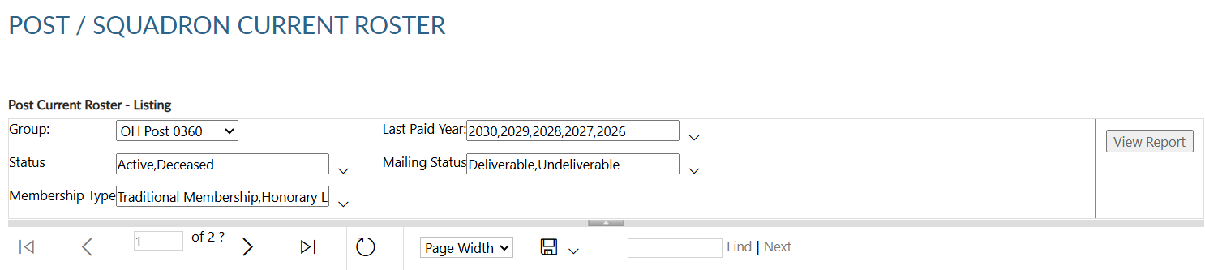
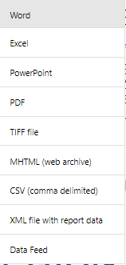
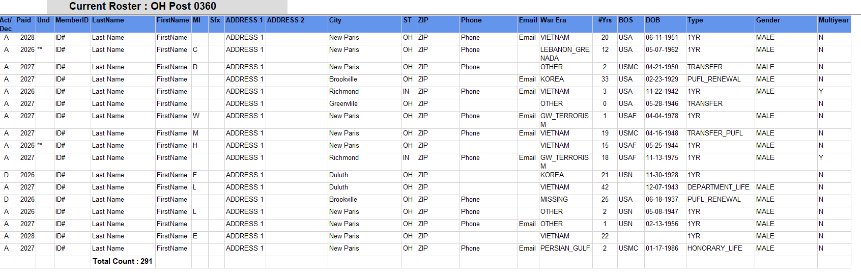
Active/Deceased
Last Paid Year
Undeliverable Address
Member ID#
Last Name, First Name, MI, Suffix
Address 1, Address 2
City, State, Zip
Phone, Email
War Era/Conflict
Continuous Years
Branch of Service
Date of Birth
Member Type / Gender
Multi-year Renewal
Notes:
The roster includes status, paid year, contact information, conflict, continuous years, branch of service, date of birth and membership type. Using the export Icon, export to an Excel document. <1>

Slide 24
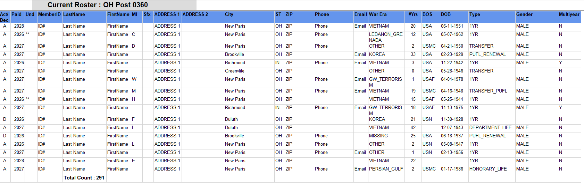
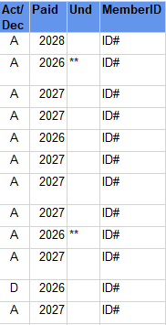

Notes:
The total at the bottom. The report includes current members only. . Members who have transferred out are not included in current membership.
<1> The members included in the report are deceased, undeliverable, expired and current members.
Undeliverable addresses are indicated by asterisk. Members with an undeliverable address do not receive renewal notices or other mailed publications. Undeliverable PUFL members will be put back into 1 year renewal status. All undeliverable addresses should be reviewed and updated through your department headquarters and national customer service.
Members who have paid for multiple years display the last paid year of the term. These members by default are paid for the current membership year.

Slide 25

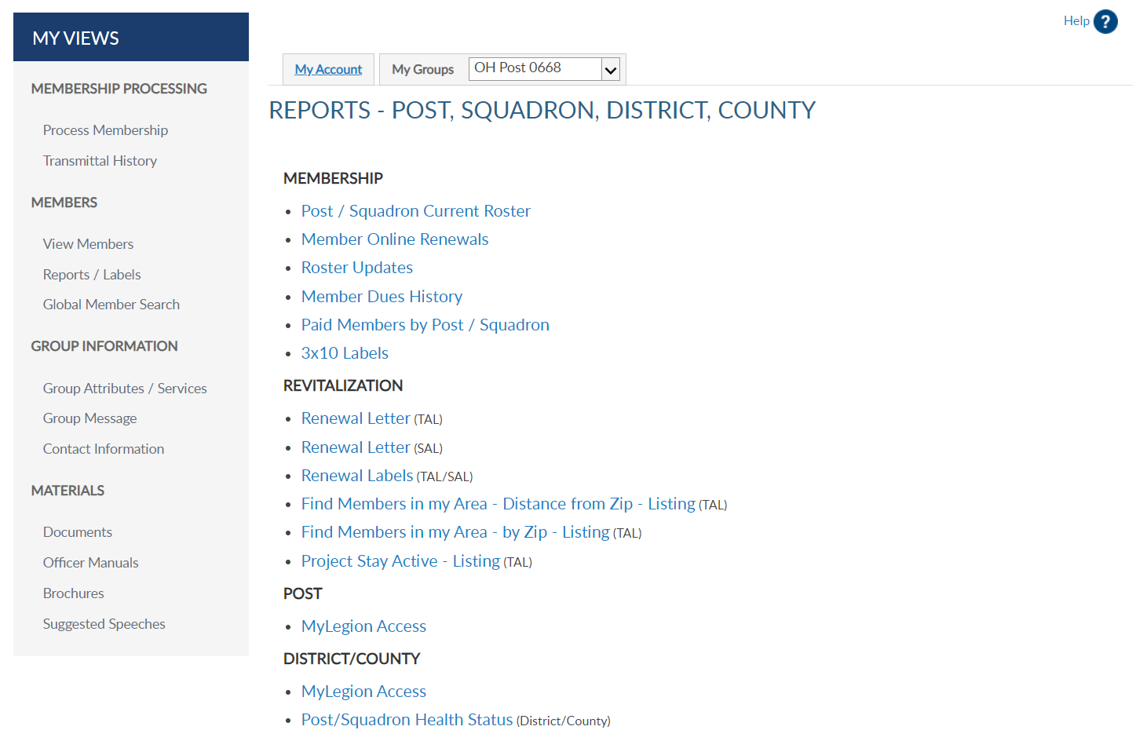



Notes:
Legion members that renew online can be identified using the Member Online Renewals Report.
Online renewal is available for Legion and Sons of the American Legion membership. Click on the blue hyperlink to begin the members online renewal report.

Slide 26

Notes:
Group selection is required. Date range selection is updated by clicking on the calendar icon. <1> Use the left and right arrows to navigate by month and year. Click on the date in the calendar to set. <2> Click View Report to generate listing.

Slide 27


MEMBER ONLINE RENEWAL
Notes:
This report provides the total count with names, member id#, date and renewal year.
<1> The export icon is used to print and save reports. Reports are not saved within the report writer.

Slide 28

Dues collected per member are determined by what is reported on the Post Data Report (PDR/SDR).
National Finance Division sends post allotment to department HQ to distribute.
Member online renewal is not available if post dues do not cover minimum of National + Dept/Detach.
Multi-year renewals display. Funds are distributed the beginning of each membership year through Department.
Notes:
The report shows the total amount of dues collected by the member, as reported on the annual post data report.
<1> When a member renews online, National collects post dues and sends all others to the department to distribute.
<2> If the post dues do not cover the minimum of national plus department, online renewal will not be available and result in an error message if the member attempts online renewal.
<3> Members who renew for multiple years display. Notice John Sample renewed for 2026 and with the multi-year renewal option, also renewed for 2027 and 2028.
Posts and department will receive future dues in July of each membership year.

Slide 29
Notes:
The next report is Roster Updates. This report helps identify members who have transferred in and out of your post or squadron, new members and other updates made on the member record.
Select the Roster Updates blue hyperlink to begin.

Slide 30


Updates to member information for address, deceased status, transfer information and new members (new join).
Notes:
Select your group and date range using the calendar icons. <1> Select update type or all. After all filters are set View Report to generate. <2>+

Slide 31

ROSTER UPDATES
Notes:
To print or save, export to an Excel Document or PDF.

Slide 32



Notes:
The report gives you information on updates made to the member record. Notice transfer information includes to and from information. Members who transfer out of your post no longer appear in current roster or current membership reports. Paid members who transfer out will be included in the Paid Members report.

Slide 33
Notes:
Dues history report displays payment information from 2011 to present.

Slide 34


Displays member payments from 2011 to current.
123456789
Notes:
Enter the 9-digit membership number and organization and click View Report. Use the export icon to save or print. <1>

Slide 35
Notes:
Payment history includes 2011 to present. If more payment information is needed, contact your department headquarters. Departments can work with national headquarters to view archived data.

Slide 36
Notes:
The Paid Members report is the report corresponding with Department membership reports. It includes all members paid for the current year, even if they transferred out.

Slide 37


PAID MEMBERS
Paid members for the current membership year. Includes members who paid yet transferred out.
Notes:
Enter organization, group, and last paid year. Click View Report to generate.<1>

Slide 38


PAID MEMBERS
Notes:
Export the report to save and print.

Slide 39
Both Encumbered and Unencumbered HQ transfers are included in this report. Please check with your department to see what counts towards annual membership goals.
Notes:
This report includes members who have paid to the post, even if transferred out. It also identifies the renewal type and batch number. The paid members’ report will correlate with department membership goals reports.
Both Encumbered and Unencumbered HQ transfers are included in this report. Please check with your department to see what counts towards their annual membership goals.

Slide 40
Notes:
3x10 labels produce a 30 per sheet label that fits Avery 5160 or any 30/sheet blank labels. Click on the blue hyperlink to set filters and create labels.

Slide 41



30 per sheet mailing labels for LGN and SAL members.
Last paid year 2023 - 2030
Notes:
Filtering options allows you to define the members included in labels. Deceased and members flagged as undeliverable will be suppressed from mailing labels.
The first step is to select the group. Next, select the last paid year or multiple years. In this example, we will select all current last paid years. <1> and sort them by zip code.
After parameters are set, View Report to continue. <2>

Slide 42


Export to PDF
Max Example
PO Box 123
Somewhere, OH 45377-2835
Thomas Sample
123 Main Street
Somewhere, OH 45377-2835
Notes:
The label display is not in 30/sheet format. Send the data to a PDF document selecting the export icon. The export icon is used print and save all reports using the file types in the menu. PDF is the only selection that applies for labels. After you select PDF look for a tab to open the PDF generally located at the lower left of your window.

Slide 43



Notes:
The PDF opens to print labels. Use the print icon to send to your printer.

Slide 44

Notes:
A renewal letter is available to reach out to expired members.
You can also create labels for renewal letters. Go to Renewal labels and use the same criteria used for letters.

Slide 45

RENEWAL LETTERS
Pre-written custom letter inviting expired members to renew. Create labels for your letter using the same filter criteria.
Notes:
Creating the letter begins with filters. Select the group first. This populates the contact’s name and title with commander information. These fields can be modified by typing new text in the fields.

Slide 46


RENEWAL LETTERS
Pre-written custom letter inviting expired members to renew. Create labels for your letter using the same filter criteria.
Notes:
Enter last paid year or multiple years and sort option. Only expired years will be available. Click View Report to generate. <1>

Slide 47


Sarah Example
We want you back!
Dear Sarah Example,
Notes:
The personalized letter generates. Letters need to be exported to print. Using the export icon, export to a PDF. <1>.

Slide 48


Notes:
The letter is personalized using member and post or squadron information including dues and dues remittance address.
<1>The bottom of the letter includes a remittance slip with dues amount and member information. If there is contact information missing, a line is provided for the member to complete and return with dues.

Slide 49
Notes:
Create an invitation to HQ members to transfer into your post using a pre-written letter.

Slide 50

Create a letter to DMS HQ members to invite them to your post.
Selecting the group adds the post commander and contact information. Update the information in the letter by updating those fields.
Notes:
Begin by selecting the group. This will auto populate the post commander, email, phone number and email address that will be in the letter. This can be updated by clicking in the text boxes to update.

Slide 51

State zip codes are available in your list to select. Only one zip code can be selected.
Notes:
Enter the zip code. Only zip codes in your state are available.

Slide 52


  Last Paid Year
Notes:
Last paid year includes current and past membership years. Members that respond to the invitation that are paid for the current membership year will have to be submitted using a Member Data Form to your department.

Slide 53


Notes:
Generate the letters by clicking “View Report”.

Slide 54

Notes:
The letters will generate. Use the export icon to send the letters to a printable document.

Slide 55

Dear Martin Allen
Print and Save Letters
Notes:
Print options allow you to save as a PDF.

Slide 56



Dear Martin Allen
Dear Martin Allen
Please login to www.MyLegion.org with email_address@yahoo.com to update your record and explore our online community.
Martin Allen: 351234567
Branch of Service: USAF War Era: GW________________
Email: myemail@yahoo.com Phone: __________________
Notes:
The letter is personalized with the member’s name and post information. <1>

Slide 57

Dear Martin Allen
Please login to www.MyLegion.org with email_address@yahoo.com to update your record and explore our online community.
Martin Allen: 351234567
Branch of Service: USAF War Era: GW________________
Email: myemail@yahoo.com Phone: __________________
Notes:
This pre-written letter invites the member to transfer.

Slide 58
TRANSFER INVITATION LETTER
Dear Martin Allen
Please login to www.MyLegion.org with email_address@yahoo.com to update your record and explore our online community.
Martin Allen: 351234567
Branch of Service: USAF War Era: ____________________
Email: myemail@yahoo.com Phone: __________________
Please login to www.MyLegion.org with email_address@yahoo.com to update your record and explore our online community.
Martin Allen
Address
City, ST Zip
Martin Allen: 351234567
Branch of Service: USAF War Era: ____________________
Email: myemail@yahoo.com Phone: __________________
Notes:
The bottom of the letter includes a signature line authorizing the transfer and provides the member with an opportunity to complete any missing information. In addition, the members’ name and address are located where you can use a window envelope.

Slide 59
Notes:
Each letter has label options. When creating labels for a renewal letter or transfer invitation letter, use the same filter options.

Slide 60
Notes:
HQ members are located using Find Members in My Area. This listing can be generated in 2 ways. Distance From Zip Code lets you select a distance using one zip code.

Slide 61


Distance From Zip: Locate headquarters post members using distance, 1 zip code and last paid year search.
Notes:
Only one zip code can be selected when using find members in my area by distance. All zips are within your state. This report is not to be used to locate members in other departments.

Slide 62


Select “View Report” to generate.
Notes:
Set last paid year and click ”View Report” to generate.

Slide 63


Last Paid Year
Member ID#
Last Name, First Name
Address
City, State, Zip
Phone, Email
Continuous Years
War Era / Branch of Service
HQ Post # (AD)
Join Date
Notes:
The report includes contact information to reach out during revitalization events.
This listing can be exported to save or print using the export icon. <1>

Slide 64


Encumbered only relates to HQ Post members.
A member that joins through the national DMS program is placed into a HQs post and dues are encumbered (AD) to national HQ until the member renews twice or is transferred to a local post.
Notes:
Post numbers that include AD are encumbered members. Encumbered only relates to HQ Post members. HQ post member’s join through the national DMS program and are placed into a HQs post. Dues are encumbered to national HQ until the member renews twice or is transferred to a local post.

Slide 65
Notes:
The other Find Members in my Area Report by Zip listing allows entry of multiple zip codes within your state and last paid years.

Slide 66



Notes:
This report allows you to select more than one zip code. Using the drop-down menus, select zip codes and last paid years.

Slide 67


Notes:
View report to generate.

Slide 68
Notes:
Locate members who have moved into your area within the last 45 days using the Project Stay Active listing.

Slide 69


PROJECT STAY ACTIVE
Locate members who have moved into your area within the last 45 days.
Notes:
Choose zip code and distance and View Report.

Slide 70


Notes:
The list provides contact information to welcome the member to the community, introduce them to your post or squadron and invite them to transfer.
As with all other reports, export to save or print. <1>

Slide 71

Notes:
Monitor who has access to your group in MyLegion using the MyLegion Access report.

Slide 72



MYLEGION ACCESS
Monitor who has access to your group in MyLegion. Adjutants and Commanders have access by default.
District / County List
Notes:
The group menu displays a list of posts or squadrons depending on your group. Click View Report to generate.

Slide 73



Notes:
Adjutants and Commanders will have permission by default. To update permissions, search the member record and go to Assign Group Permissions. Only adjutants and commanders can assign and remove group permissions.

Slide 74
Notes:
District and County reports include a post officer report.

Slide 75



Notes:
Group selection will include district or county groups only. Select the group and View Report.

Slide 76


Notes:
A list of officers for all post/squadrons in the group appears. Export to save or print.

Slide 77

Notes:
The post officer’s report provides all officer assignments and contact information. If any information is incorrect, contact department headquarters. All officers are reported to the department.

Slide 78
Notes:
District and County reports include Post/Squadron Health Status.

Slide 79



Monitor post and squadron membership processing and consolidated reporting.
District and county are the only groups available for this report.
Notes:
Monitor membership processing and consolidated reporting for posts and squadrons in your group. Group selection will include district and county groups. Enter your group, last paid year and View Report.

Slide 80


Notes:
Export the file to save or print.

Slide 81
Notes:
The list provides post or squadrons with their last transmittal date, number of unpaid members, consolidated report status, and address information.

Slide 82

MY ACCOUNT & HELP RESOURCES
12/31/2027
000123456789
20
5/31/2028
12/31/2027
000123456789
5
Notes:
Online help is available from the top Menu “Find Help”.
Step by step instructions, videos and training presentations will assist with how to manage groups in MyLegion.

Slide 83

Online Help
Notes:
Step by step instructions, videos and training presentations will assist with how to manage groups in MyLegion. My Groups instructions include managing membership, online, membership processing, reports and all other administrative tasks.

Slide 84
MYLEGION SUPPORT
Contact your MyLegion support team to assist with any questions or tools on your MyLegion account.
MyLegion@legion.org
833.253.9995
Monday – Friday
8:00am – 4:30pm (Eastern)
Notes:
Contact your myLegion support team to assist with questions and tools for MyLegion. Email mylegion@legion.org or call 833-253-9995 Monday through Friday.

